Slide 1
Revolutionizing eCommerce: Unleashing Business Innovation with Generative AI
Business Innovation in Commerce and Fintech / through Rakuten Business

Slide 2
Visual Search and Product Discovery
Visual image-based search is crucial in e-commerce for several reasons
Personalization: Visual search data can be used to enhance personalization efforts.
Faster Decision-Making: Shoppers often have a clear picture of what they want but struggle to articulate it in words.

Slide 3
Enhancing Search and Understanding Through Multimodal Integration
Leveraging Multimodality Models
Prompt Generation
Image Selection
Embedding Fusion
Enhanced Contextual Understanding

Slide 4
Input Modalities: User Interaction
Image Upload
Users can input images by directly uploading them from their devices.
URL Submission
Another option is to provide a URL to an image hosted online.
Voice Command
For hands-free interaction, users can generate images using voice commands, enhancing accessibility.

Slide 5
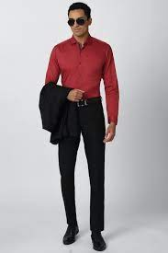
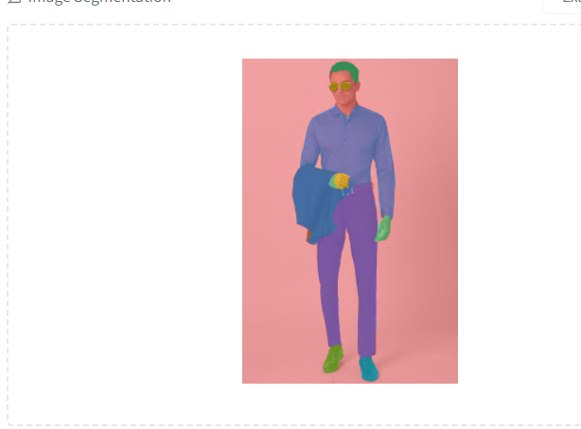
Step 1: Unveiling User Search Intent: A Deep Dive

Slide 6
Step 2: Crafting Effective Text Prompts
Social Media Trend Analysis: Conduct trend analysis on social media platforms like Twitter, Instagram, and Facebook using their APIs.
Location-Based Insights: Consider location (pin code) to determine factors like allowed voltage, battery life, and the nearest service center.
Seasonal Trends: Analyze data based on time of year, including holidays like Diwali, Christmas, vacation seasons, and major events like world cup competitions.
Customer Profiles: Utilize historical order data and browsing behavior analysis. Apply entity mining techniques on product descriptions and reviews for valuable insights.

Slide 7
Step 3: Optimizing Text Prompts
A prompt refinement is needed in this context to ensure its logical alignment with the accompanying image. e.x. voltage, battery life not required for clothing’s.
We can utilize image captioning/description or visual QA approach.
Topic Modelling.

Slide 8
Step 4 : Leveraging Diffusion-Based Models for Multimodal Fusion
Utilizing Stable Diffusion
We employ the stabilityai/stable-diffusion-xl-base-1.0 model.
Combining Text and Image
The model integrates text and image seamlessly, leveraging its comprehensive understanding of both modalities.
Logical Fusion
The fusion process is driven by the model's inherent logic, resulting in cohesive multimodal outputs.

Slide 9
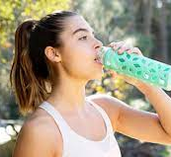

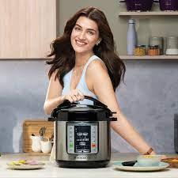
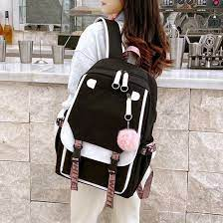
Generating Logical Representation of Existing Products
Considering an image of a product accompanied by its attributes, user reviews, and rating information.

Slide 10
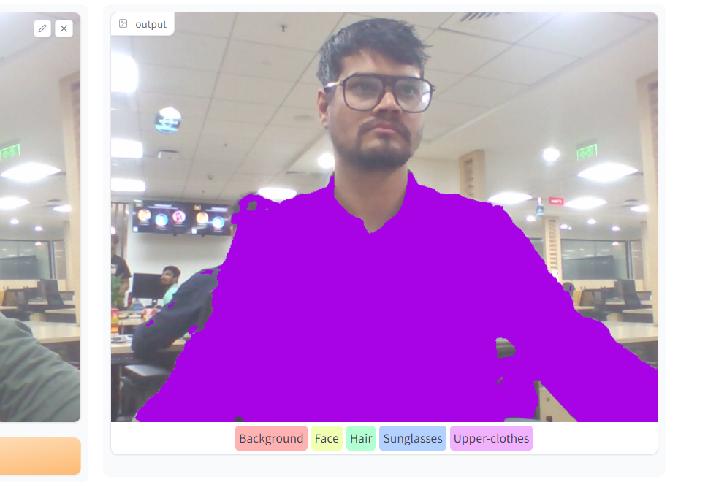
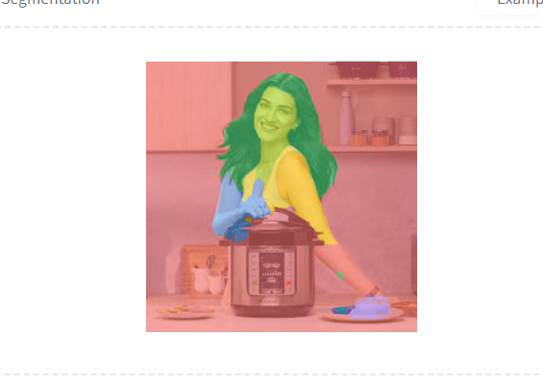
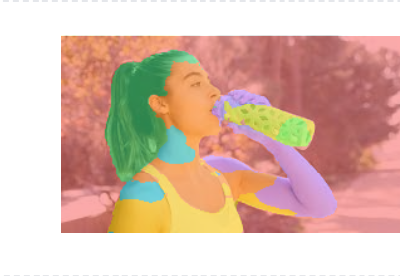
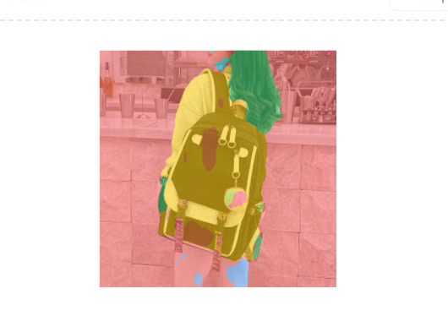
Image Noise Handling: Creating Image Masks

Slide 11
Crafting Effective Text Prompts
Social Media
Trends extracted from reviews and product description.
User insights
allowed voltage, battery life, service center.
Based on time of year
Diwali, Sports, Christmas, vacation, rainy, winter, cold etc.
Product profiles
Based on product description and aspects.

Slide 12
Managing Product Vector Embeddings
Weaviate vector DB.
Vertex AI Implementation
Any otherRAG-Based Approach

Slide 13
Personalised Customer Experiences
Generative AI for Personalization
Combines Generative AI for tailored product suggestions.
NCF + LLM Integration
Integrates Neural Collaborative Filtering (NCF) and Large Language Model (LLM) to boosts recommendation precision.

Slide 14

NCF-Based First-Level Recommendations
Obtaining first level recommendation from NCF based algorithms like Bayesian Personalized Ranking.
BPR is able to capturing complex user-item interactions
capturing complex user-item interactions

Slide 15
Harnessing LLM for Prompt-Based Suggestions
prompt = "Generate personalized product recommendations for User X. User X has previously purchased items such as [List_of_purchased_items] and has been browsing web pages related to [List_of_web_pages_visited]. Please suggest products that align with their interests and preferences." X = "User attributes like Age, Gender, pincode" List_of_purchased_items = "item and it's small description" List_of_web_pages_visited = "product and it's small description" Latest_trends = "Based on social media, review and events mining" Add_extra_details = "Allergic to specific cloth type or flat foot"
Perform prompt optimization and employ Langchain agents for product recommendations.

Slide 16
Incorporating Neural Collaborative Filtering (NCF) in conjunction with Large Language Model (LLM).
Incorporating recommendations generated by Neural Collaborative Filtering (NCF) as an option for Language Model (LLM) or to generate similar product recommendations.
Prompt will be modified with
The beatles
prompt += Generate recommendations from below choices
the beach boys.
the rolling stones
john lennon
bob dylan ................ or generate alike to given above.
the beatles

Slide 17
Providing real-time, context-aware customer support interactions
Instruction fine-tunning of LLM using Rakuten web pages and app screen along with actions and their outcome.
task = "return order"
Prompt = Generate a step-by-step workflow from the current screen to accomplish the intended {task}. This involves outlining a systematic sequence of actions and interactions required to successfully complete the specified task starting from the current user interface screen.

Slide 18
Automating insurance claim processing
Obtain Questions from forum, legal claim sites, previous data and with curators.
Given input : Claim Documents
Add Document in LegalGPT as context and the extract information required for queries.
Implemented using Langchain

Slide 19
References
Hugging Face: https://huggingface.co/
Google Colab: https://colab.research.google.com/
Google Images: https://images.google.com/
OpenAI: https://openai.com/
Langchain: https://www.langchain.com/

Slide 20
Thank You
Queries

